Slide 1
Lecture-8
Chapter - 4
Computer Organization and Architecture Designing - William Stallings
Cache Memory

Slide 2
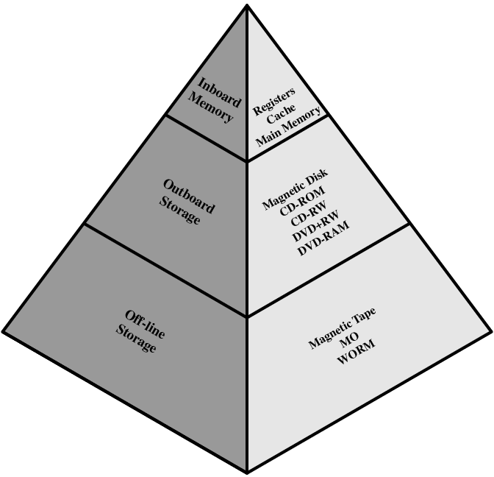
Memory Hierarchy
Registers
In CPU
Internal or Main memory
May include one or more levels of cache
“RAM”
External memory
Backing store
Fig: Memory Hierarchy Diagram

Slide 3
Performance
Access time
Time between presenting the address and getting the valid data
Memory Cycle time
Time may be required for the memory to “recover” before next access
Cycle time is access + recovery
Transfer Rate
Rate at which data can be moved

Slide 4
Hierarchy List
Registers
L1 Cache
L2 Cache
Main memory
Disk cache
Disk
Optical
Tape

Slide 5
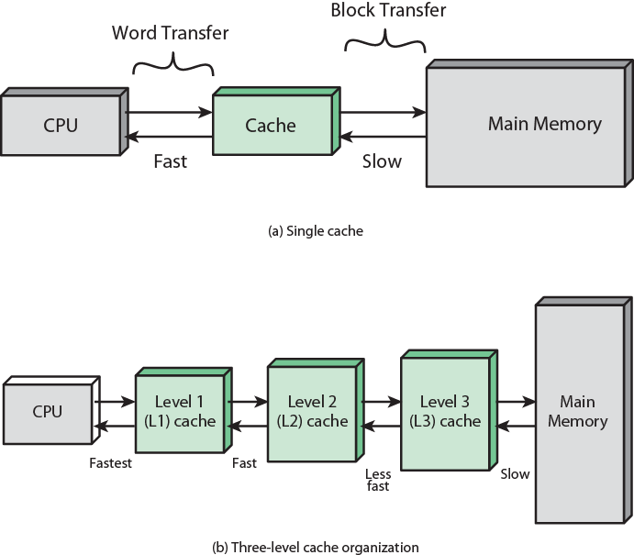
Cache and Main Memory
Small amount of fast memory
Sits between normal main memory and CPU
May be located on CPU chip or module

Slide 6
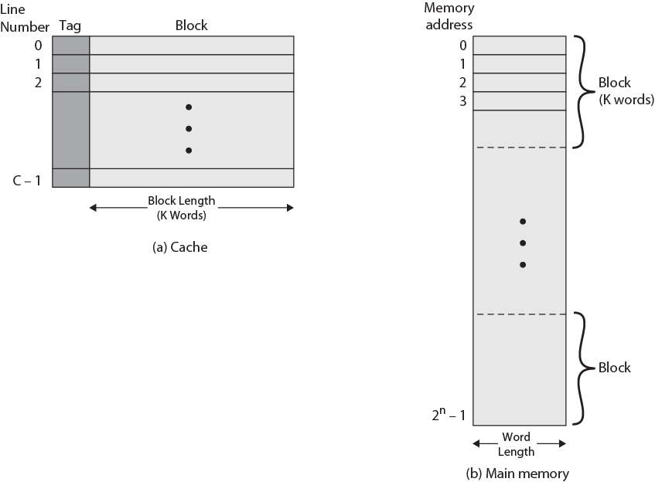
Cache/Main Memory Structure

Slide 7
Cache operation – overview
CPU requests contents of memory location
Check cache for this data
If present, get from cache (fast)
If not present, read required block from main memory to cache
Then deliver from cache to CPU
Cache includes tags to identify which block of main memory is in each cache slot

Slide 8
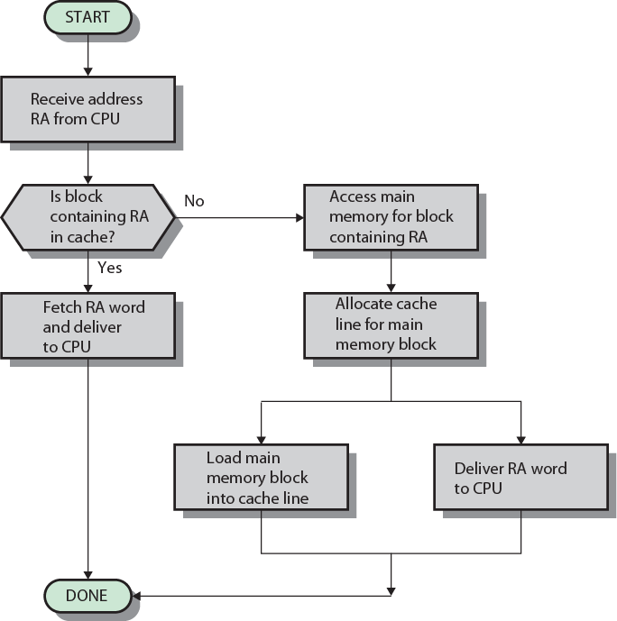
Cache Read Operation - Flowchart

Slide 9
Cache Addressing
Where does cache sit?
Between processor and virtual memory management unit
Between MMU and main memory
Logical cache (virtual cache) stores data using virtual addresses
Processor accesses cache directly, not thorough physical cache
Cache access faster, before MMU address translation
Virtual addresses use same address space for different applications
Must flush cache on each context switch
Physical cache stores data using main memory physical addresses

Slide 10
Mapping Function
The cache can hold 64 Kbyte
Data can be transferred between main memory and the cache in block of 4 bytes each
i.e. cache is 16k = 2¹⁴ lines of 4 bytes each
Main memory consists of 16Mbytes, 24 bit address directly addressable 2²⁴ = 16M
--i.e. 4M blocks of 4 bytes each

Slide 11
Direct Mapping
Each block of main memory maps to only one cache line
i.e. if a block is in cache, it must be in one specific place
Address is in two parts
Least Significant w bits identify unique word
Most Significant s bits specify one memory block
The MSBs are split into a cache line field r and a tag of s-r (most significant)

Slide 12
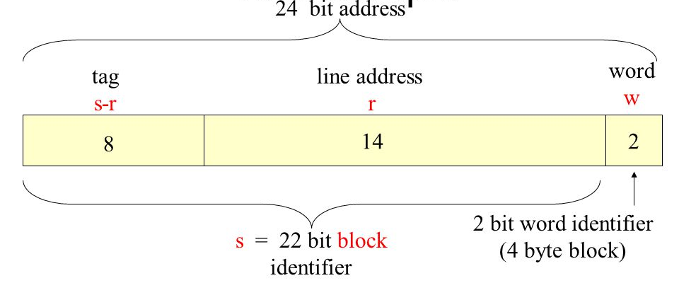
Direct Mapping Address Structure
24 bit address
2 bit word identifier (4 byte block)
22 bit block identifier
8 bit tag (=22-14)
14 bit slot or line
No two blocks in the same line have the same Tag field
Check contents of cache by finding line and checking Tag

Slide 13
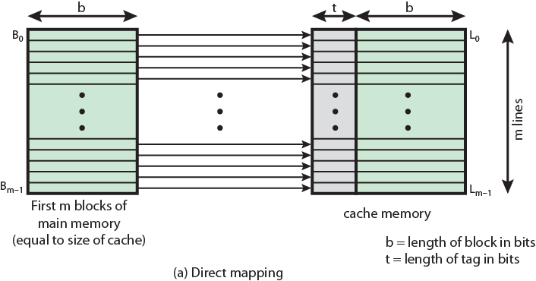
Direct Mapping from Cache to Main Memory

Slide 14
Direct Mapping Summary
Address length = (s + w) bits
Number of addressable units = 2^{s+w} words or bytes
Block size = line size = 2^{w} words or bytes
Number of blocks in main memory
= 2^{s+ w}/2^{w} = 2^{s}
Number of lines in cache = m = 2^{r}
Size of tag = (s – r) bits

Slide 15
Direct Mapping pros & cons
Simple
Inexpensive
Fixed location for given block
If a program accesses 2 blocks that map to the same line repeatedly, cache misses are very high

Slide 16
Associative Mapping
A main memory block can load into any line of cache
Memory address is interpreted as tag and word
Tag uniquely identifies block of memory
Every line’s tag is examined for a match
Cache searching gets expensive

Slide 17
Associative Mapping Address Structure
Tag
22 bits
Word
2 bits
22 bit tag stored with each 32 bit block of data
Compare tag field with tag entry in cache to check for hit
Least significant 2 bits of address identify which 16 bit word is required from 32 bit data block
e.g.
Address Tag Data Cache line
FFFFFC FFFFFC 24682468 3FFF

Slide 18
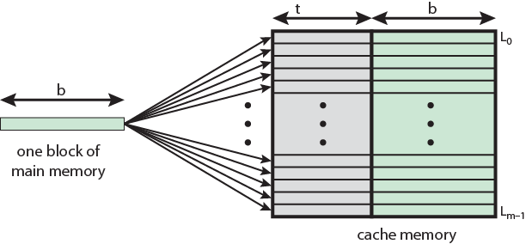
Associative Mapping from Cache to Main Memory

Slide 19
Associative Mapping Summary
Address length = (s + w) bits
Number of addressable units = 2^{s+w} words or bytes
Block size = line size = 2^{w} words or bytes
Number of blocks in main memory
= 2^{s+ w}/2^{w} = 2^{s}
Number of lines in cache = undetermined
Size of tag = s bits

Slide 20
Set Associative Mapping
Cache is divided into a number of sets
Each set contains a number of lines
A given block maps to any line in a given set
e.g. Block B can be in any line of set i
e.g. 2 lines per set
2 way associative mapping
A given block can be in one of 2 lines in only one set

Slide 21
Set Associative Mapping Address Structure
Word
2 bit
Tag 9 bit
Set 13 bit
Use set field to determine cache set to look in
Compare tag field to see if we have a hit
e.g
Address Tag Data Set number
1FF 7FFC 1FF 12345678 1FFF
001 7FFC 001 11223344 1FFF

Slide 22
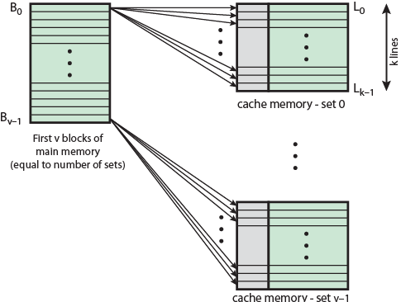
Mapping From Main Memory to Cache: v Associative

Slide 23
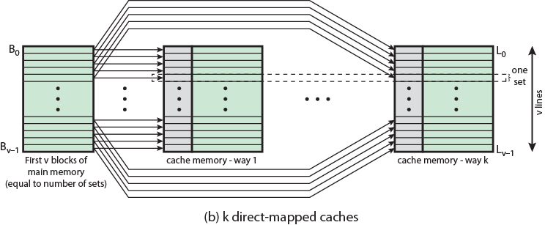
Mapping From Main Memory to Cache: k-way Associative

Slide 24
Set Associative Mapping Summary
Address length = (s + w) bits
Number of addressable units = 2^{s+w} words or bytes
Block size = line size = 2^{w} words or bytes
Number of blocks in main memory = 2^{d}
Number of lines in set = k
Number of sets = v = 2^{d}
Number of lines in cache = kv = k * 2^{d}
Size of tag = (s – d) bits

Slide 25
That’s All Thank You

